Slide 1
AI & Big Data에 꼭 필요한 최적화 기법 실습캠프
Fundamental Optimization Techniques Essential for Artificial Intelligence and Big Data Analytics
Mentoring for Optimization Problems and Python Language
Sang Jin Kweon (권상진)
School of Management Engineering UNIST
TA | Seungok Woo (우승옥) Email: wso1017@unist.ac.kr Office Hours: by APPT.
Office hours:
Email:
Tel:
Web:
after class (or by APPT.)
sjkweon@unist.ac.kr
+82 (52) 217-3146
http://or.unist.ac.kr

Slide 2

Acknowledgement

Slide 3
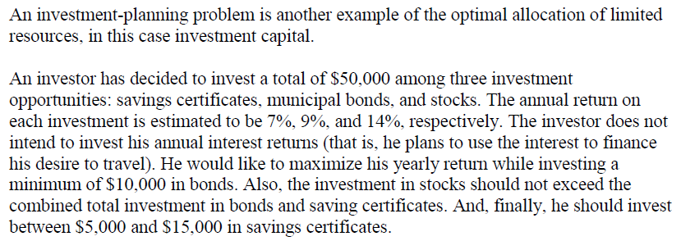
EXAMPLE 2: Investment Planning Problem

Slide 4
LP Formulation
Decision variables:
The objective function is to maximize yearly return:
Constraints:
Constraint 1: total investment ≤ 50,000
Constraint 2: investment in bonds ≥ 10,000
Constraint 3: invest. in stock ≤ invest. in saving certificates + invest. in bonds
Constraints 4-5: limits on investment in savings certificates
Additional set of constraints (non-negativity Constraints)

Slide 5
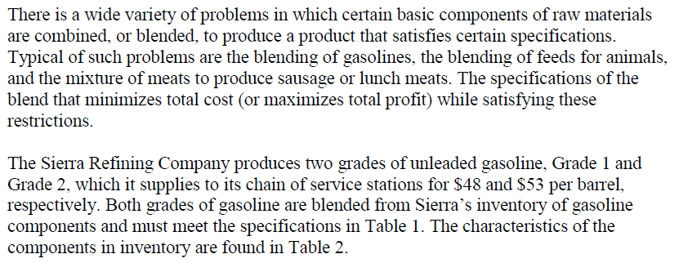
EXAMPLE 3: Product-Blending Problem

Slide 6
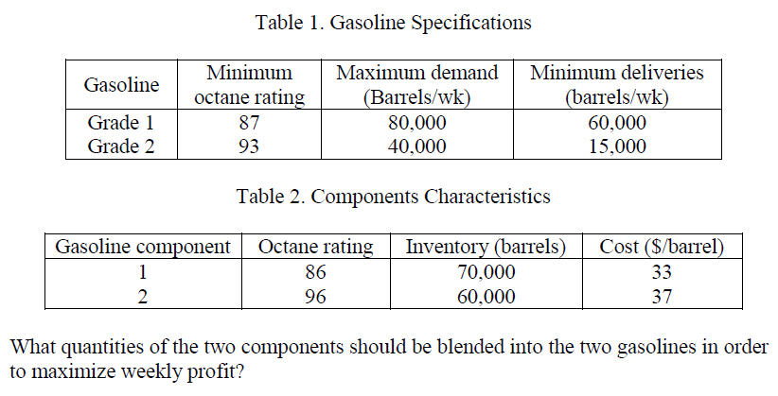
(cont.)

Slide 7
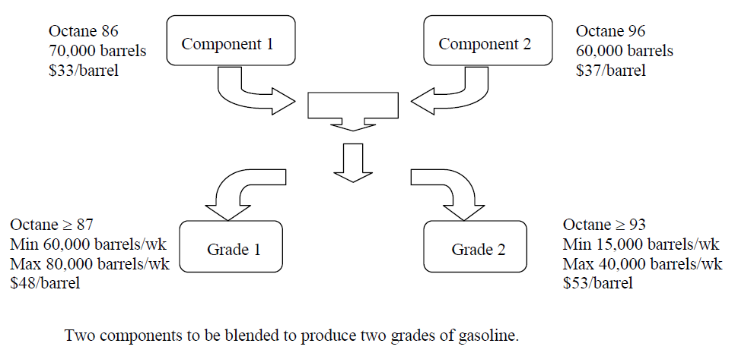
LP Formulation

Slide 8
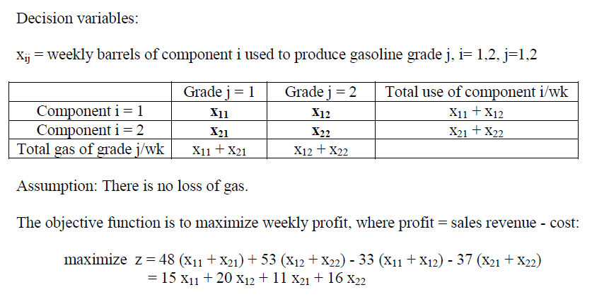
(cont.)

Slide 9
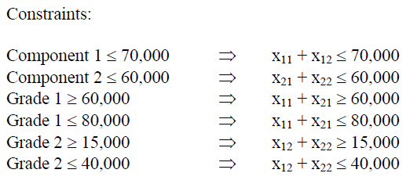
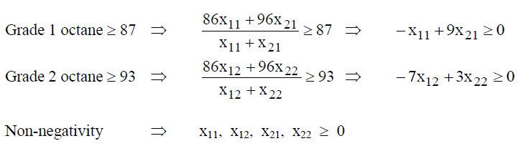
(cont.)

Slide 10
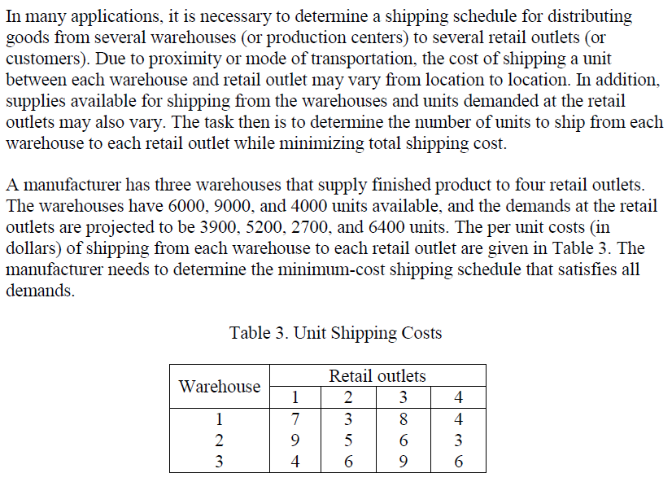
EXAMPLE 4: Transportation Problem

Slide 11
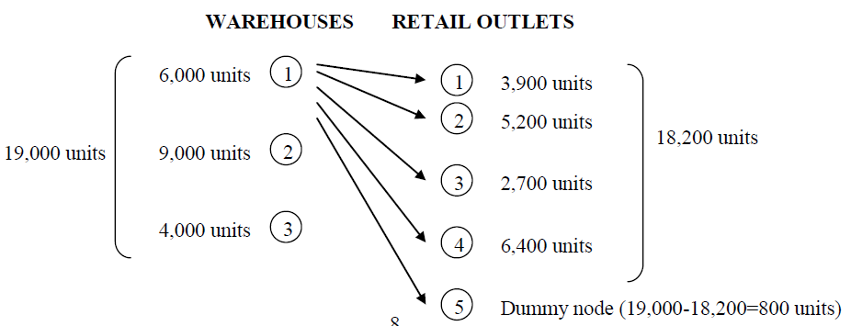
LP Formulation

Slide 12
LP Formulation
Decision variables:
The objective function is to minimize total shipping cost:
Constraints:
3 Warehouse Constraints:
5 Retail Outlet Constraints:
Non-negativity Constraints:

Slide 13
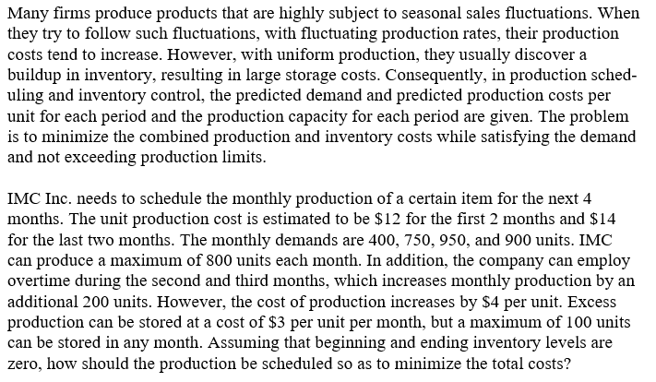
EXAMPLE 5: Production-Scheduling and Inventory Control Problem

Slide 14
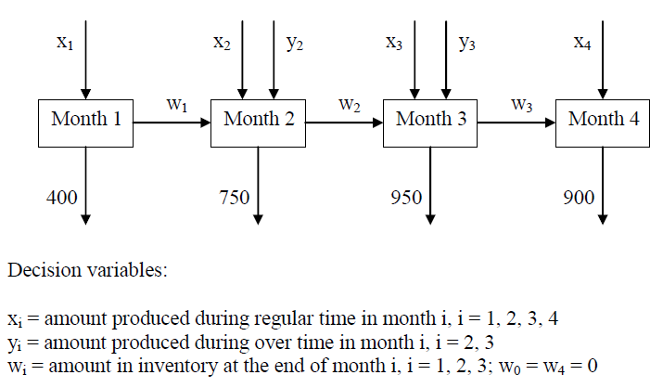
LP Formulation

Slide 15
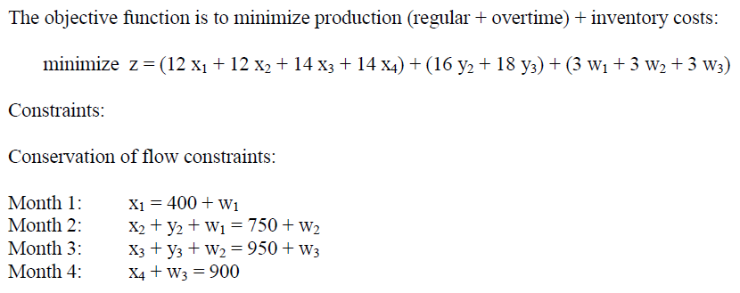
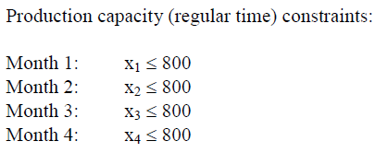
(cont.)

Slide 16
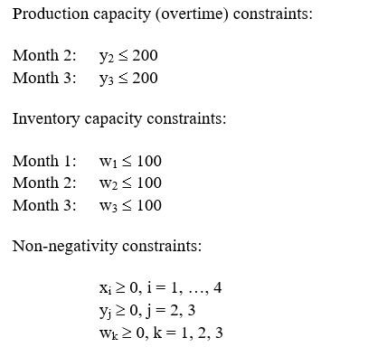
(cont.)

Slide 17
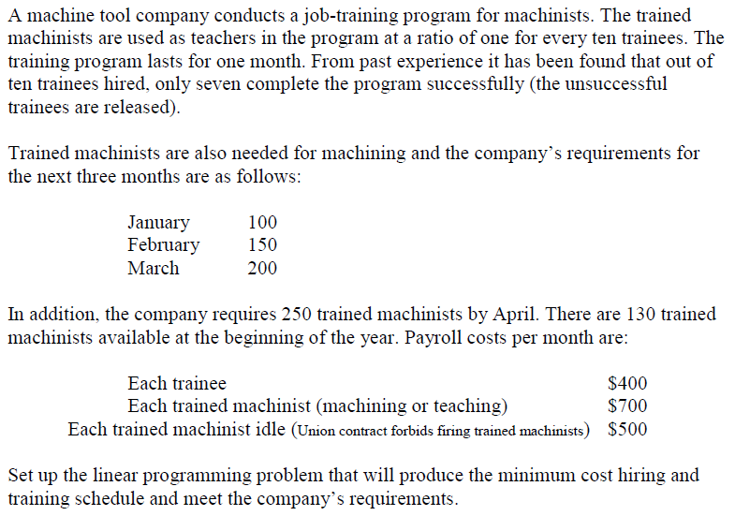
EXAMPLE 6: Job-Training Problem

Slide 18

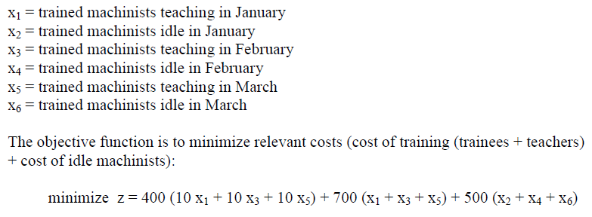
LP Formulation

Slide 19
(cont.)

Slide 20
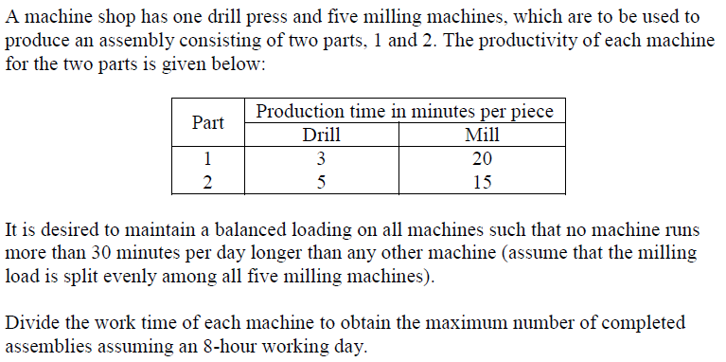
EXAMPLE 7: Machine Shop Production Planning Problem

Slide 21

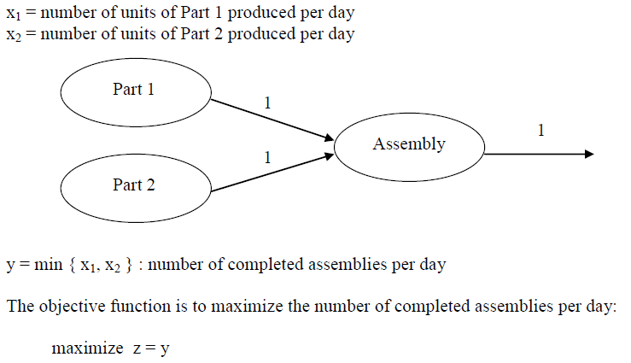
LP Formulation

Slide 22
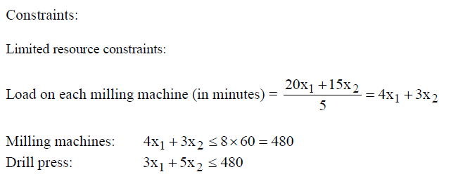
(cont.)

Slide 23
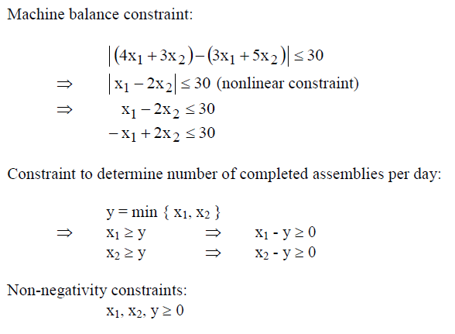
(cont.)

Slide 24




Summary of LP Formulation

Slide 25
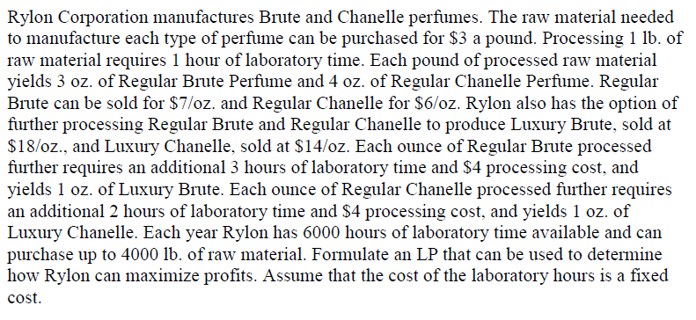
EXAMPLE 8: Another Resource Allocation Problem

Slide 26
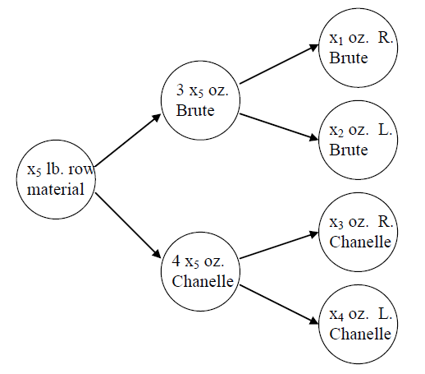
LP Formulation

Slide 27
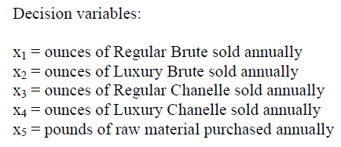
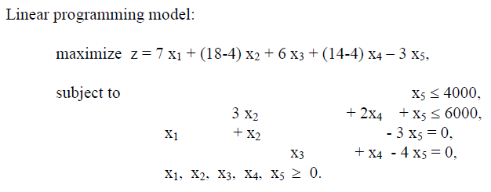
(cont.)

Slide 28
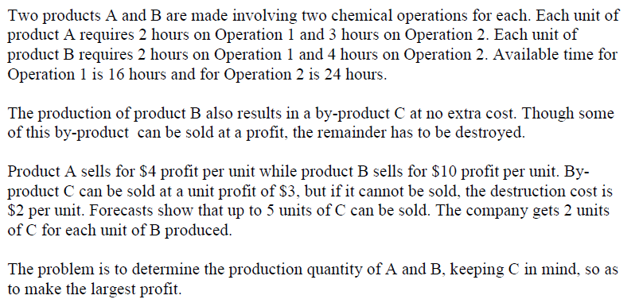
EXAMPLE 9: Production Planning in Chemical Co.

Slide 29
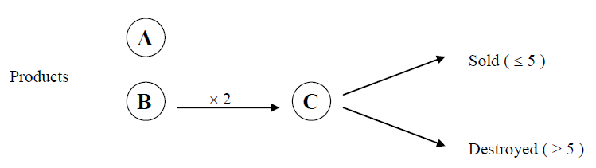
LP Formulation

Slide 30
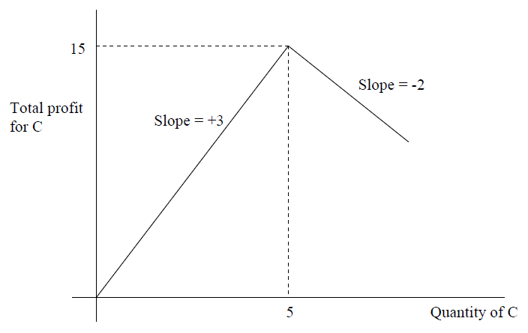
(cont.)

Slide 31
(cont.)
Decision variables:
The objective function is to maximize total profit:
Constraints:
Constraint 1: 2 × (amount of product B) = amount of product C ⇒
Constraint 2: Demand constraints
Constraint 3: Constraints of available operation times
Constraints 4: Non-negativity constraints:

Slide 32
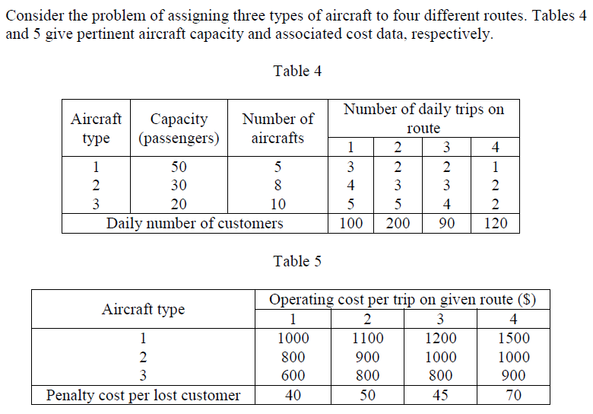
EXAMPLE 10: Aircraft Routing Problem

Slide 33
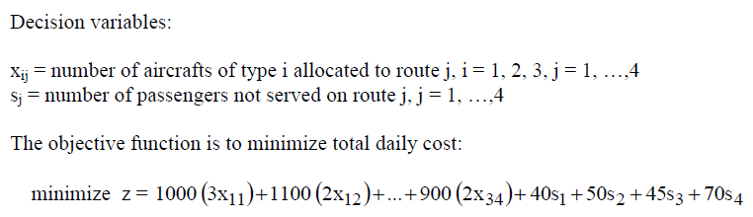
LP Formulation

Slide 34
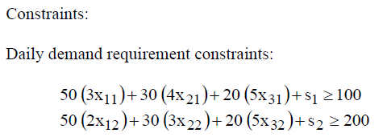
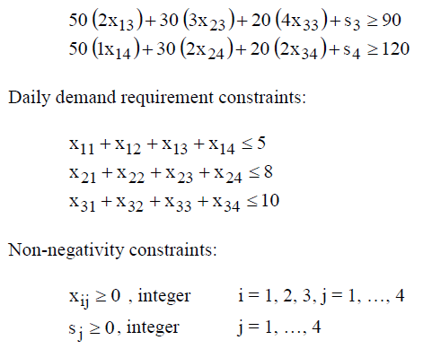
(cont.)

Slide 35
https://github.com/SeungokWoo/SW_Optimization_Camp
Genetic Algorithm in python – Solving Password

Slide 36
Acknowledgement

